Slide 1





GIT Miners
01
June 24 ,2021

Slide 2




Presentation outline
02
Problems Solutions Product intro
Benefits and highlights Research
Advertising methods Social media advertising Timeline
Logo studies Product mockups Video marketing

Slide 3



PROBLEM 1
03
There is lack of good services related to medicine delivery and collection of samples for different tests
PROBLEM 2
It is difficult to get specialised doctors ,because of their tight schedule and due to which a patient has to run in to many places to see if the specialist he needs is available at the moment.
PROBLEM 3
Problem
A person has to go to a lot of hassle while getting or donating blood ,our service eases it out

Slide 4


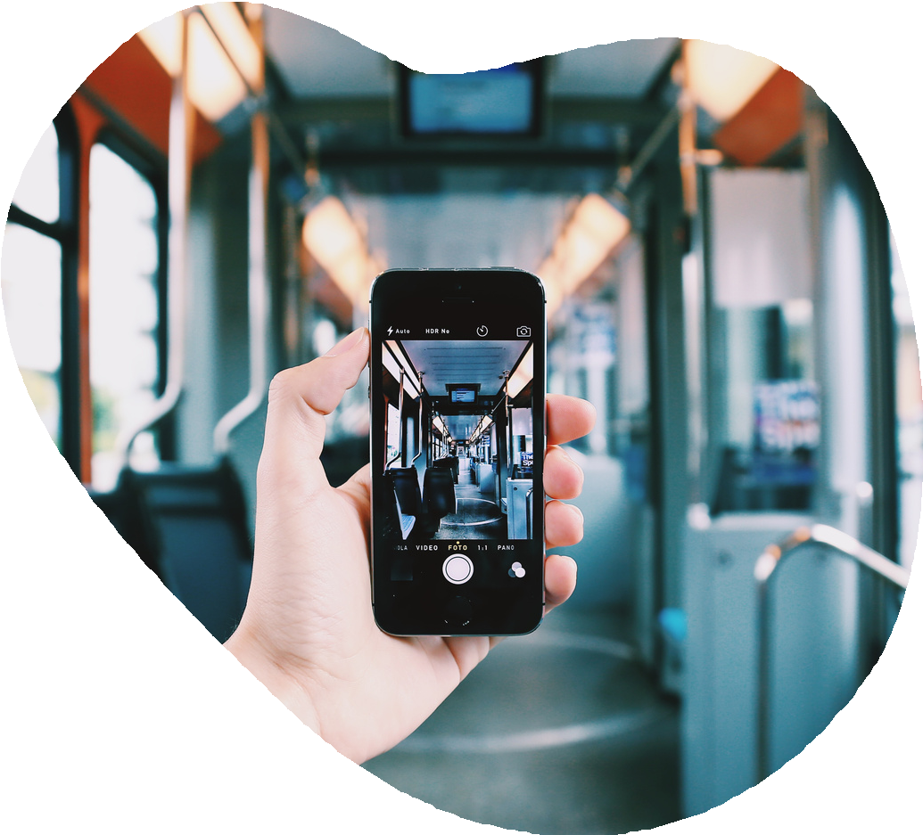

SOLUTION 1
04
door step drug delivery blood/urine test pickup
SOLUTION 2
Connection of doctors. patient, suggest doctor to visit who will be able to assist you at the moment Schedule appointment
SOLUTION 3
Solution
Provides with an AI which has a large database and stores user's medical details and monitor his daily conditions.

Slide 5


Product or service
05
Our product is an AI based app which will help analyze user's data and will make a more personalized medical assistance.

Slide 6



Benefits and highlights
06
FEATURE 1
FEATURE 2
FEATURE 3
There will a group of hospitals registered and the AI will suggest and book the appointment according to the patient's necessity
Provides with medical sample pickup facility.
Our Huge Database will securely store the prvious medical record of our patients, and will analyze them later to predict diseases or raise a warning with high Precesion.

Slide 7


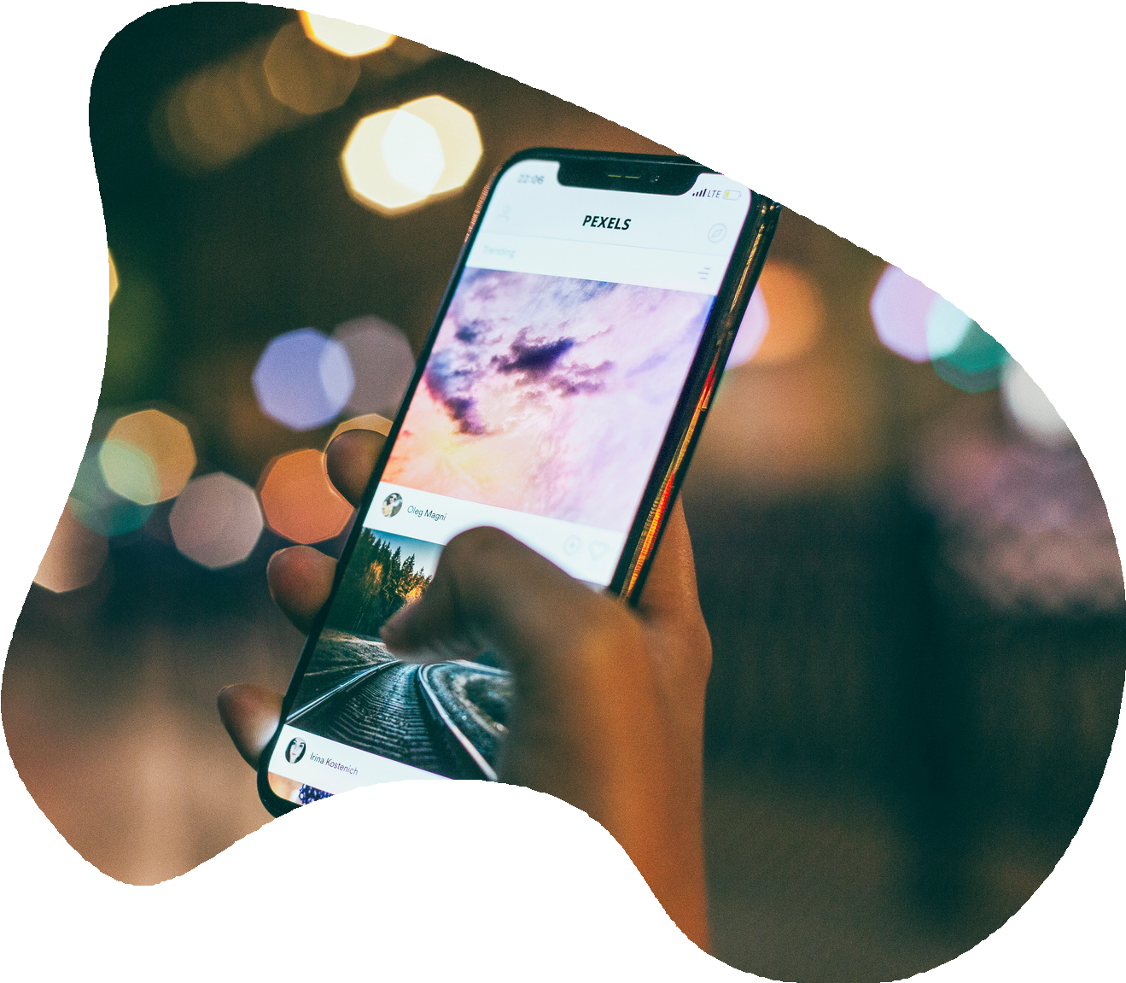

COMPETITORS
07
At present there are no competitors as this idea is a novel one.
OUR PRODUCT / SERVICE
An AI which gives personalised assistance to each paitient

Slide 8


DOOR STEP DELIVERY OF MEDICINES
Our servie offer delivery of the medicines at the doorstep
PROBLEM IDENTIFICATION
Based on the symptoms it will tell the type of problem faced by the person.
Benefits and highlights
MAINTAINS MEDICAL RECORD
It will maintain the medical record of the patient which will help doctors to understand the situation of the patient.

Slide 9

APPOINTMENT BOOKIING
People can book an appointment with the doctor.
EASY TESTING
For various testing samples can be taken at their home according to the convinience of patient.
Benefits and highlights
BLOOD DONATION
Willin people can donate blood directly from their home.

Slide 10


The Team
15
Advertising Presentation | December 2020
ROSHAN KUMAR
ABHIJEET PATNAIK
VIVEK KUMAR MOHIT PAL

